Slide 1
DIGITIAL PORTFOLIO
STUDENT NAME: Mary S REGISTER NO: 222407926 NMID: autumn1455bsc215 DEPARTMENT: B.Sc Computer Science COLLEGE: Tagore College Of Arts And Science

Slide 2
DIGITIAL PORTFOLIO

Slide 3
AGENDA
Problem Statement
Project Overview
End Users
Tools and Technologies
Portfolio design and Layout
Features and Functionality
Results and Screenshots
Conclusion
Github Link

Slide 4
PROBLEM STATEMENT
In today’s digital world, students and developers need a platform to showcase their skills, education, projects, and achievements. Traditional resumes are limited, whereas an online portfolio provides an interactive and professional way to present information to recruiters, clients, and peers.

Slide 5
PROJECT OVERVIEW
This project is a Personal Portfolio Website created using HTML, CSS, and JavaScript. The portfolio highlights academic background, skills, hobbies, and projects, while also providing a contact form for communication.

Slide 6
END USERS
Recruiters & Hiring Managers – to evaluate skills and qualifications Clients – to explore technical expertise before collaboration Peers & Faculty – for academic and professional networking General Public – to know more about the developer

Slide 7
TOOLS AND TECHNOLOGIES
HTML5 – Structure of the website CSS3 – Styling and layout design JavaScript – Interactivity and form handling Git & GitHub – Version control and hosting GitHub Pages – Deployment of the portfolio

Slide 8
PORTFOLIO DESIGN AND LAYOUT
Header Section – Profile name and introduction About Me – Personal introduction and academic background Education – Details of school and college qualifications Skills & Hobbies – Technical skills and personal interests Projects – Source code links to GitHub Contact Me – Simple form for communication Responsive Design – Works well on both mobile and desktop

Slide 9
FEATURES AND FUNCTIONALITY
Modern and responsive user interface Clean section-based design (About, Education, Skills, Projects, Hobbies, Contact) Contact form for easy communication Direct GitHub link to access projects Screenshots for better visualization

Slide 10
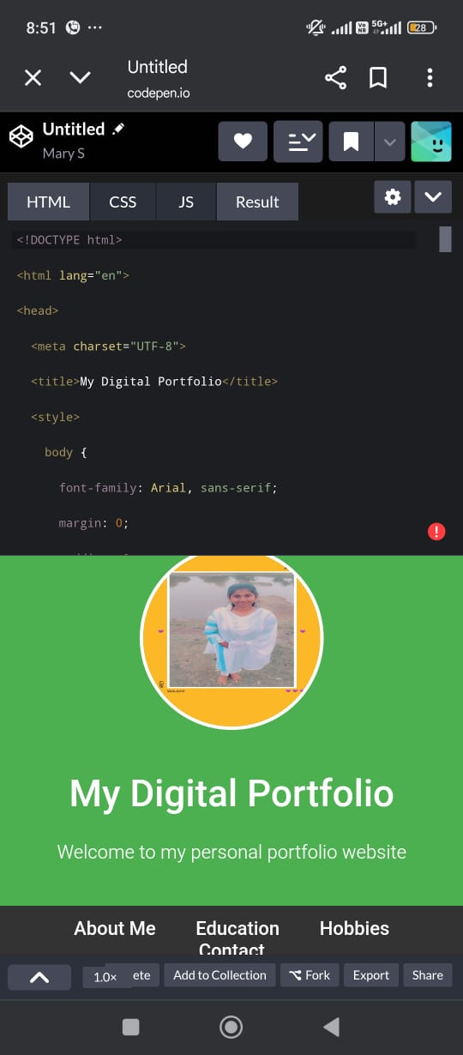
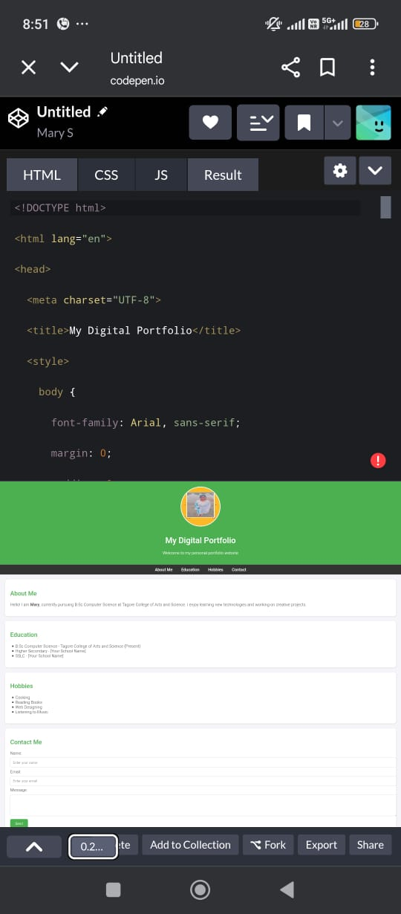
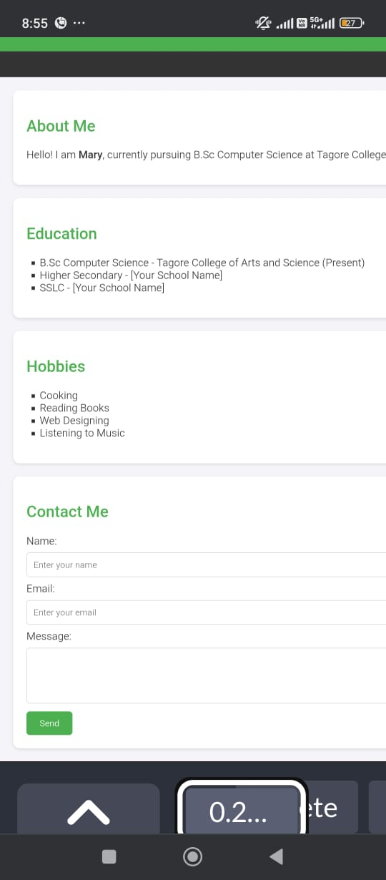
RESULTS AND SCREENSHOTS
This is my portfolio result
HTML,CSS and Javascript are very important to create the result like this .

Slide 11
CONCLUSION
The portfolio website serves as a digital resume and enhances online presence. It reflects the ability to use frontend development technologies effectively and is a valuable tool for career opportunities.

